Slide 1

Hello from Cole & Weber
November 2014

Slide 2
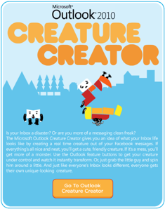
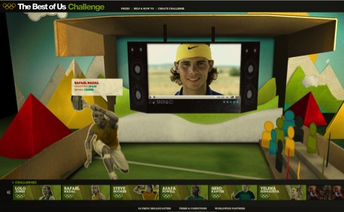
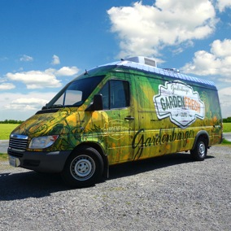

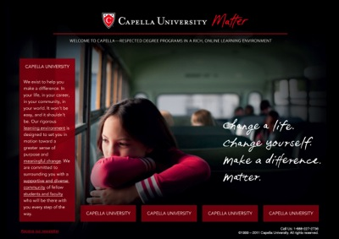
We help clients grow by involving people in brand experiences
Notes:
Founded in 1931, the same year as Herman Devry was founded Devry.

Slide 3
Because involvement has real business value
Involvement builds consideration.
Involvement builds preference.
Involvement builds repeat purchase.
Involvement drives
conversation and sharing.
Involvement lessens
price sensitivities.
Involvement builds loyalty and
referrals.

Slide 4




And most of all, involvement drives growth
Grown into a national advertiser and the fastest-growing brand in the category.
Grown loyalty rate to be the best in the category.
Grew the business by double digits for the first time in 10 years. Grew their player base.
Grew connection to global youth, surpassing events like the X Games and World Cup
in relevance. Grew young people’s viewership of the Games by 40%.
Grew share of preference in customer electronics, outpacing Best Buy and Walmart.
Grew involvement with young women and increased margin by 11%.
Grown year over year passenger counts and revenue.
Notes:
Today, the agency

Slide 5

Building involvement requires the right skills
Digital rigor
Innovation
of a creative boutique
Strategic consultancy
Notes:
Today there are three things at the heart of what we do that make us unique.

Slide 6
With a structure to deliver
The magic is in the overlaps
Notes:
The impact of this for clients

Slide 7
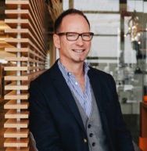
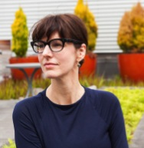
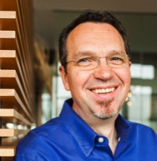
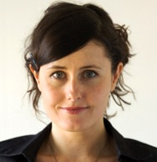
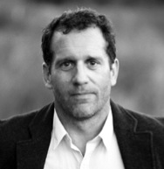
And the right team
Mike Doherty - President
Mike joined Cole & Weber United nearly 16 years ago as managing director of the Portland office. During his time there, the agency doubled in size and added accounts such as Nike Retail. In 2000, he moved to Seattle and took over the agency helm. As president, he oversees client strategy and agency operations, and explores new ways to expand the boundaries of traditional advertising to create business value for our clients. Since joining the agency, CWU has built a line of furniture, produced a TV show, created new media units and produced code that enabled Microsoft to syndicate streaming content across the Web. He has worked in both B2B and consumer marketing for clients that include Gallo, Nike, Microsoft, Dell, Target, Honda and Pabst.
Elizabeth Rowny - Managing Director
Before jumping into the agency world, Elizabeth worked as a change management consultant at Pricewaterhouse-Coopers where she created business growth strategies for Nestlé, Unilever, BP, Mercedes and BofA. Since then, she has focused much of her career on building global brands for packaged goods companies. Her experience includes brand marketing for Coca-Cola, and brand positioning and communications work for Alexia (ConAgra), Reddi Whip, Athenos (Kraft), Kraft Corporate, GSK, MARS/ Dove Chocolate and Pedigree Dog Food.
James Mackenzie - Strategic Planning Director
James is charged with uncovering rich insights that lead to disruptive ideas and business growth. Its his job to look beyond the obvious to unlock powerful ideas that lead to long-term sustainable business advantages. James was an early pioneer in the integration of multi-disciplined, 360° brand strategies and joined Cole & Weber United with 20 years of U.K. advertising experience where he worked on global brands like Visa International. Specifically relevant to you, he has deep experience in package goods working with leading brands that include Gallo, Tree Top, Kellogg’s, Target, Pabst, Chateau Ste. Michelle, and Atkins.
Jessica Michaels - Digital/Social Strategy Director
Jess has written integrated creative and digital brand strategy for the following companies: Macy’s, Harrods, IKEA, Microsoft’s Xbox, Sony PlayStation, Activision Blizzard, Warner Bros., Paramount, Disney, Sparkling ICE, Campbell’s, YUM Brands, LVMH and Chanel. Digital and social strategist. Jess will continue to develop and deploy integrated digital strategy across paid, owned and earned media.
Pat McKay - Executive Creative Director
Pat recently joined Cole & Weber but has been a regular contributor to the agency as a freelancer and now brings more than 20 years of experience to the role. He’s worked as a creative director at agencies like Wieden & Kennedy London and Goodby, Silverstein & Partners in San Francisco on brands such as Got Milk?, Comcast, Honda, Arla Foods UK, Microsoft, The Commonwealth Bank of Australia, Nestea Europe, and Starbucks. Not to mention a slew of other brands as a young writer and creative. His work has been recognized by Cannes, The One Show, The Clios, D&AD, New York Art Directors Club, London International, The Effies, Andy Awards, Yahoo! Big Idea Chair Awards, The Webbys, AICP, The Kellys, CA Magazine, Los Angeles Belding Awards and The Emmys. Pat gets excited about making work. You’ll notice he moves his hands around a lot.
Elizabeth Rowny - Managing Director
Before jumping into the agency world, Elizabeth worked as a change management consultant at PricewaterhouseCoopers where she created business growth strategies for Nestlé, Unilever, BP, Mercedes and BofA. Since then, she has focused much of her career on building global brands for packaged goods companies. Her experience includes brand marketing for Coca-Cola, and brand positioning and communications work for Alexia (ConAgra), Reddi Whip, Athenos (Kraft), Kraft Corporate, GSK, MARS/ Dove Chocolate and Pedigree Dog Food.
Notes:
Mature problem solvers, business partners and good listeners.
Part of WPP, so also have all the resources of a large agency but with the senior attention and close relationships of a boutique. Flat senior org of problem solvers.

Slide 8
Here are a few examples of how this comes to life

Slide 9
Trident Seafoods
Relevance: Building a brand position and then articulating it in a meaningful way.
The world’s largest, vertically integrated fishing company (that no one has heard of…yet)

Slide 10
Trident Seafoods
Their CEO was very clear–
We’re a family company who operates with one goal:
Be the best from source to plate
but…

Slide 11
Our job was to bring clarity and dimension to their business strategy
“People don’t buy what you make, they buy why you do it.” - Simon Sinek
We naturally communicate from the outside in, from the clearest to the fuzziest
Facts and figures make rational sense, but don’t inspire action
Iconic brands, leaders that inspire action, communicate from the inside out
A simple and honest frame work for Trident that starts with why
WHY
WHAT
HOW

Slide 12

WHY
We believe fish is the food of our future
HOW
We act as protectors of the source
WHAT
We are a committed family of fishermen

Slide 13
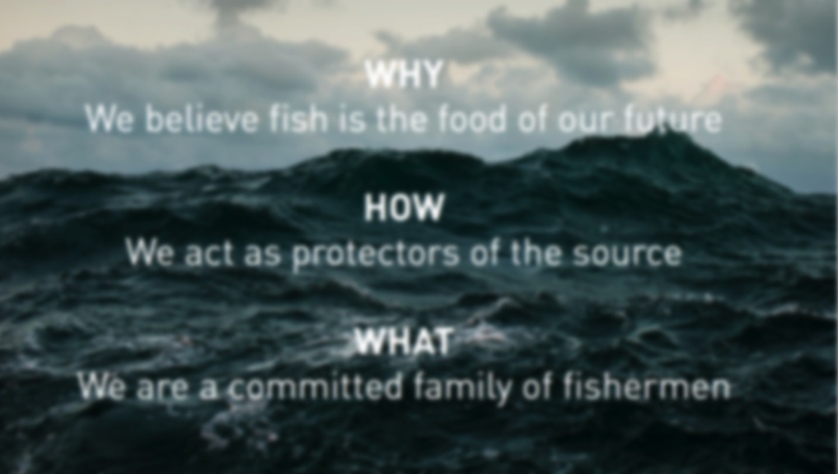
MESSAGING ARCHITECTURE
RELEVANCE TO DIFFERENT AUDIENCES IS ACHIEVED BY FOCUSING ON KEY THEMES AND SHIFTING EMPHASIS OF WHY, HOW, WHAT. FOR EXAMPLE…
CONSUMERS | CUSTOMERS | FISHERMEN
WHY: As the Champions of Fish, we believe fish is food for our future. | WHY: We are category leaders, publicly championing fish to drive demand for consumers. | WHY: As Champions of Fish, we are fighting to preserve your livelihood.
HOW: We fish with responsibility and humility. We manage this resource that has been entrusted to us for abundance, not just sustainability. | HOW: We are a trustworthy partner that our customers always rely on for category expertise, insight-led innovation, and consistency of supply. | HOW: We fish with responsibility and humility. Together we manage this resource that has been entrusted to us for abundance, not just sustainability.
WHAT: We catch only the best, and are able to preserve freshness and flavor the moment it comes over the rail to the moment it goes on the plate. | WHAT: We catch only the best, and are able to preserve freshness and flavor the moment it comes over the rail to the moment it goes on the plate. | WHAT: Fishermen have been, and will always be, the nucleus of our family.

Slide 14
From:
Silos
Fragmented portfolio built via
M&A & innovations
Sales focused instead of
audience focused

Slide 15
Evolving to:
Everyone knowing their role
Clearly defined priorities
Audience focused
2
BUSINESSES
PARTNERS
Brokering
1
Akutan
3
Pier 91
FISHERMEN
PROCESSING
FOOD SERVICE
DINERS
Trident Fleet
Innovation
Sales
Independents
Marketing
4
RETAILERS
SHOPPERS

Slide 16
International Olympic Committee
Relevance: Bringing a brand’s values to life in a way that engages a new generation.
Notes:
Bringing an analog institution into digital

Slide 17
The challenge
Notes:
Viewership was aging, playership is aging
Bringing an analog institution into digital
Governing body so they are about regulating the use of their logo and properties
To be relevant, have to make the Games and the movement accessible and sharable to a younger audience but within acceptable guidelines.

Slide 18

We discovered shared values
STRIVING FOR SUCCESS
Empowered, Determined,
“5 Minutes of Fame” Generation
CELEBRATION OF COMMUNITY
Most global and connected
generation in history
POSITIVE HUMAN
Most global and connected
generation in history
Notes:
Looked behind the heritage and tradition at what the brand stood for.
There are three core values:
Encouraging effort which relates to Striving for Excellence
Preserving Human Dignity which relates to Demonstrating Respect
Developing Harmony which is about Celebrating Friendship

Slide 19
And built a brand platform
EXCELLENCE
FRIENDSHIP
RESPECT
Notes:
Brand platform that connects all three of those things. The best of us in terms of competition, the best of us as global community and what we value in each other. Each Games cycle we create TV spots that drive to an experience where people participate in the Olympic Movement and share their participation.
In short, the movement had always been
about celebrating The Best of Us – individually
and collectively. As people, as countries, as a
global community. That idea drove everything
we did.

Slide 20

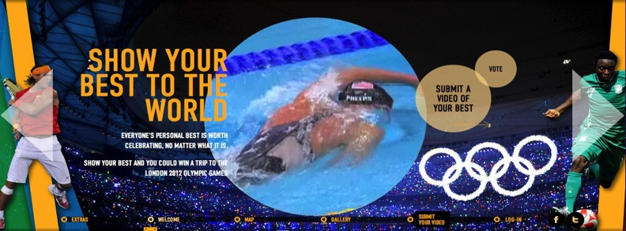
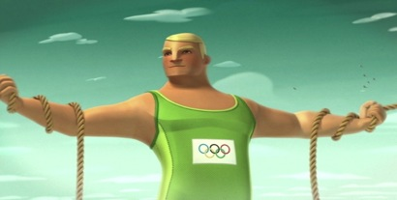
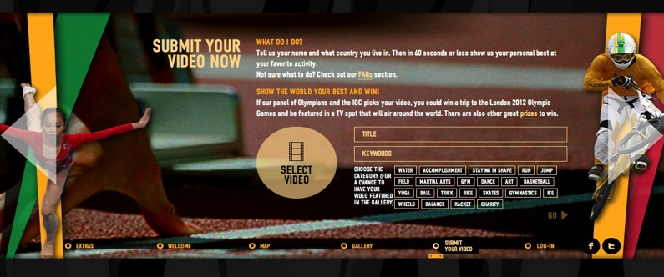

Then we made the movement accessible
Notes:
500 million unpaid media impressions uploads from 60 countries, and 158 countries viewed the videos for an average of 6.5 minutes
We’ve seen interaction from 158 countries and received uploaded content from 58 countries including Brazil, India and China.
Over 1/3 of all visitors voted on other people’s content. Both our share and interaction rates outpaced industry benchmarks by double
digits in every country. And users spent an average of 6 minutes, 40 seconds on the site per visit. That’s over 350,000 minutes or 243
days spent with the Olympic brand.

Slide 21
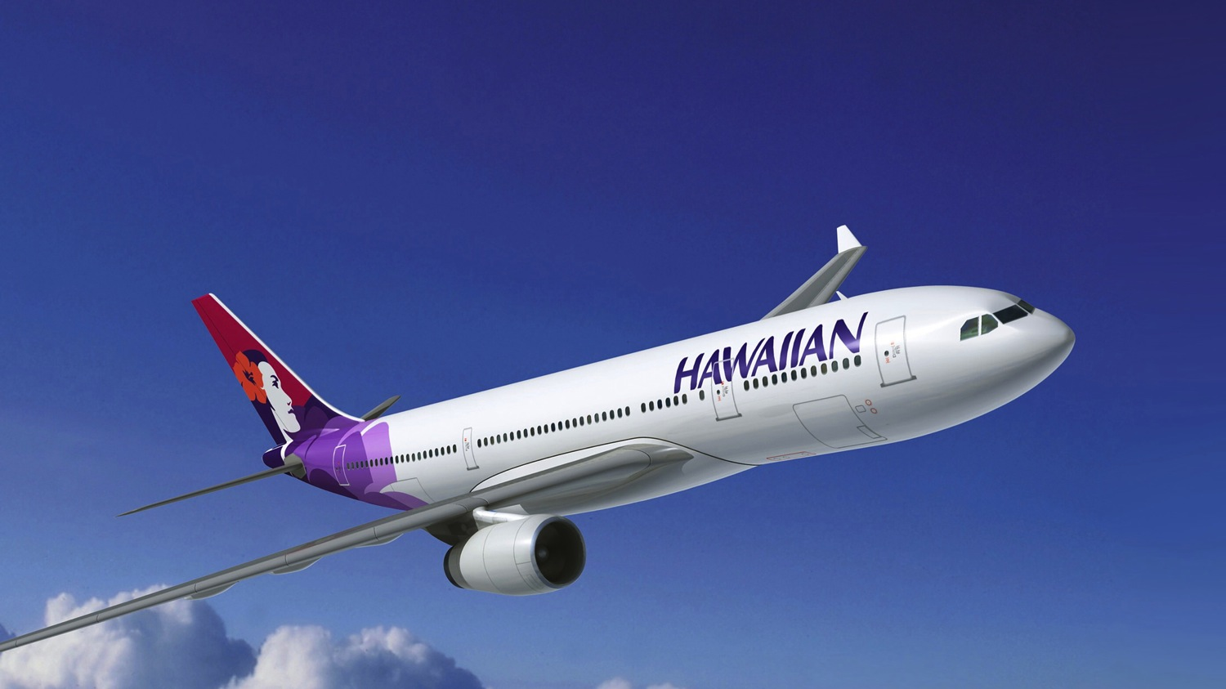
Hawaiian Airlines
Relevance: Building a brand through a DR program that increases direct bookings at a lower cost and a higher ROAS

Slide 22
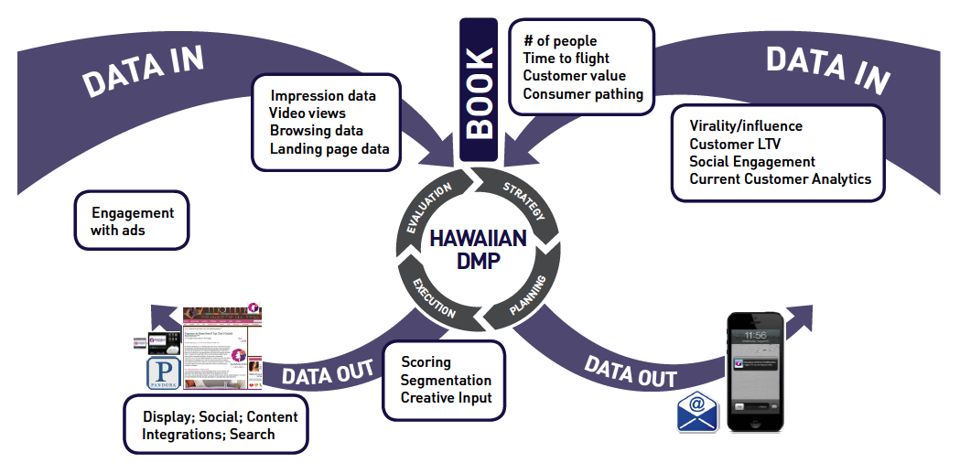
We started with a proprietary data management platform
Notes:
Build audience profiles,
Geo and audience targeted messages
Look a like models
Aligned paid earned and owned

Slide 23
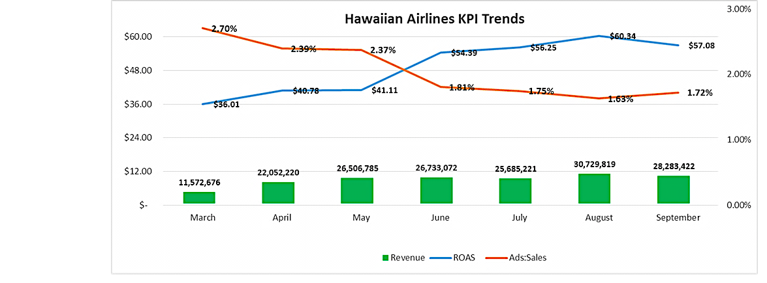
And we’ve made good progress

Slide 24
Enough about us, lets talk about you

Slide 25
The education industry is in flux
“Online education is a disruptive innovation—one that introduces more convenient and affordable products or services that over time transform sectors.”
“We predict that existing consumers will ultimately adopt the disruption, and a host of struggling colleges and universities— the bottom 25 percent of every tier—will disappear or merge in the next 10 to 15 years.”
– Clayton Christensen,
Harvard Professor of Business Administration
Source: November 2013 NY Times

Slide 26
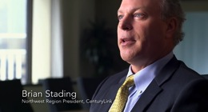
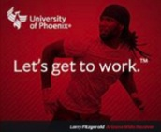
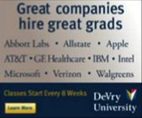
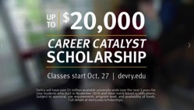

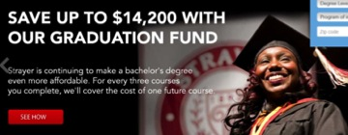
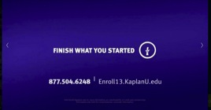


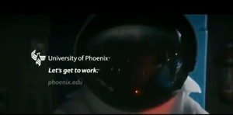

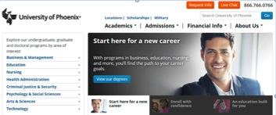
Meanwhile, it’s still hard to differentiate
Using employer endorsements and implied job guarantees
Reducing risk and fear
Promising a new path for your potential
Notes:
Using employer endorsements and implied job guarantees
• Alumni at every fortune 100 company to open doors
Reducing risk and fear
• Advertising cost reductions
• Trial programs
• Free courses
Promising a new path for your potential
• The career you want starts here

Slide 27
To be successful, we need to tap into the bigger cultural need

Slide 28
Changing nature of a degree
In 2013, 33.5% of Americans (25 to 29) had at least a bachelor’s degree, compared with 24.7% in 1995, and just 21.9% in 1975.
  National Center for Education Statistics
And It’s harder today to earn a middle-class wage without a college degree.
  High school grads make up just 41% of the US workforce
  All of the net job growth since the 1970s is in occupations that require post-secondary education
And yet, only 46% of Americans complete college once they start.
  Organization for Economic Cooperation and Development
“There’s more than 30 million people that have some college but no degree”

Slide 29
These 30 million Americans don’t need a degree that’s accessible, they need a degree they can complete.
So which schools could be best placed to solve their need, and how?
What are the problems that have been stopping them?
What are the most effective ways of solving some of those problems for them?
What will look like good enough value to them, to unlock the F.U.D. of postponed decision-making?

Slide 30
Understanding the impact of millennial values is key
An aversion to debt
Work that
has a life
(not a chore or a hobby)
From “work-life balance” to a richer mix of life and work
Non-linear life path
A sharing culture
Renting to ensure mobility

Slide 31
It means the rules are changing
The ROI of a college degree isn’t measured against a single lifelong career
  3 years and $30,000 looks like an uncertain bet if you expect to change paths in 5 years
Being given credit for what you’ve done and know, is a big emotional benefit
  As well as transferable credits
  Your completer scholarship is great way of acknowledging this
The flexibility of campus and online is more than convenience
  It is how you tailor a solution to completion, and personalize the experience
As people keep switching paths and embracing new tangents, they may always be ‘degree completer’ prospects
  Very different to colleges’ wishful label of “lifelong learners”
  A brand for this generation is one that empowers that open-ness to change, and the agility they want to upgrade and adapt their qualifications to new opportunities
  DeVry’s portfolio and infrastructure could be ideally suited to this

Slide 32
DeVry could be uniquely suited for the new rules
Mutual profitability requires smart segmentation
Different to Kaplan’s strategy
DeVry
Incompleters
Hybrid model
Beyond Community Colleges
Competency credit
Brand vs. program
Not a pendulum of internal politics: should be driven by student needs…
For Flexers, not Failers
WGU does this well at every stage
Could we also invent & own the next-gen, hybrid community college?
Most online enrollments
are within 75 miles
Tangible community
Rich open spaces downstream?
Ex: a resurgence
in apprenticeships?
Learn anywhere,
graduate here
Keeping options open
beyond an Associates’

Slide 33
Brand and program should be inextricably linked
MOVIES
NOT
CINEMAS
PROGRAM:
PROGRAM:
Program inspires
and motivates
Program qualifies
for shortlist
(via specificity)
Different needs
and constraints for success and persistence
Specific outcomes, networking, follow-up
Brand reassures
(legitimacy)
Brand value, tone
and standards
(shared assets and playbook)
BRAND:
BRAND:
Confidence to change course within DeVry (eg DKB)
&
emotional (re)motivation and reassurance
Makes DeVry 1st choice
to upgrade
and adapt degree later
MODELS
NOT
MEDIATORS
PURCHASE PATH
LEARNING EXPERIENCE

Slide 34
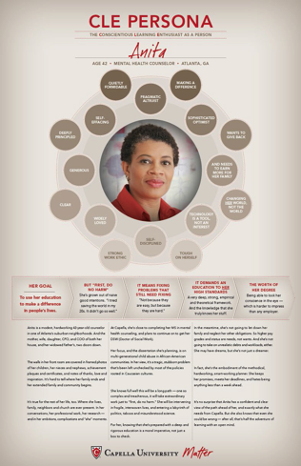
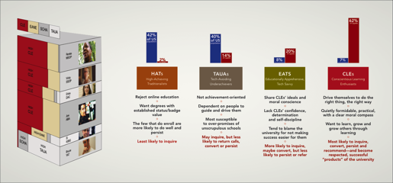
And we can create shared insights across programs
Customer intimacy as a model
Customer
segmentation

Slide 35
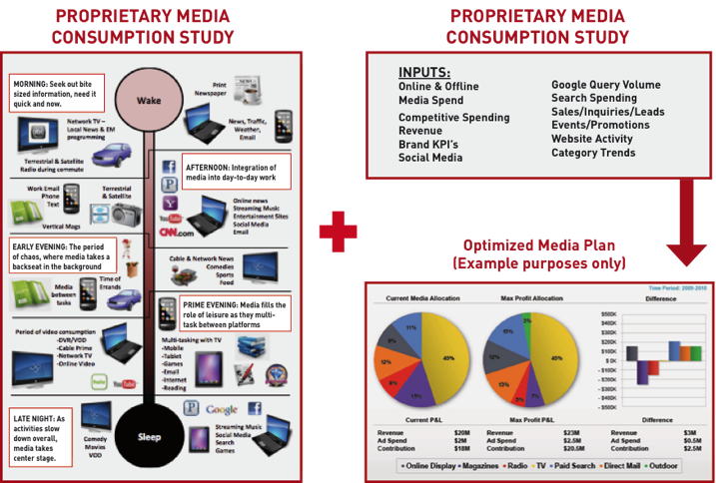
And an optimized media playbook
Notes:
James, waterfall analysis?

Slide 36
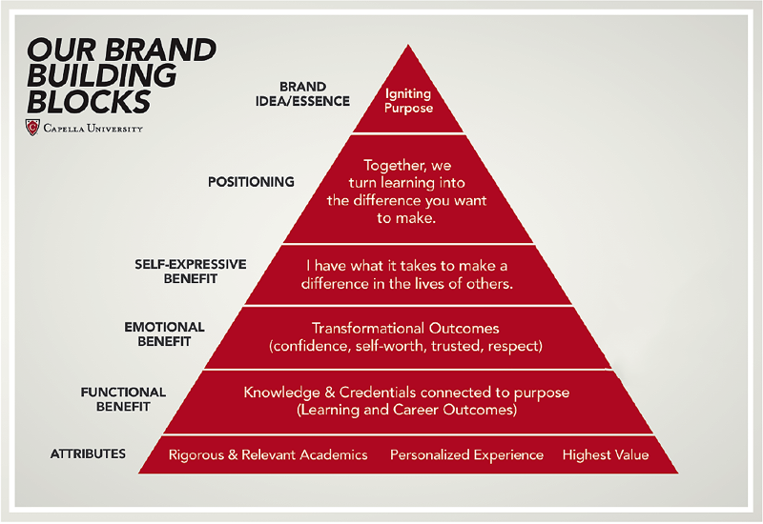
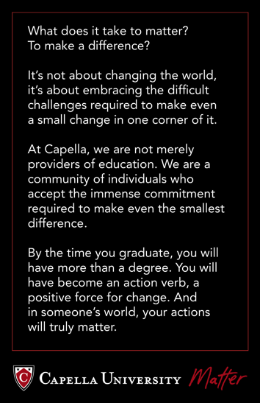
Inspired by a singular point of view

Slide 37

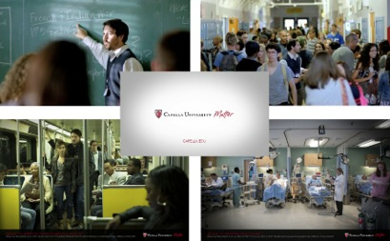
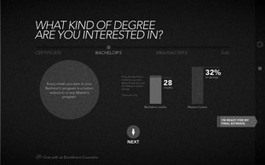
And an integrated creative approach
Show our Difference
Elevate our Reputation
What we Offer
Tools to Help

Slide 38
Sharing the benefits of constant innovation
Notes:
And responding to the market changes.

Slide 39
But hey, what do we know?
DeVry’s business is very different to Capella
We haven’t talked to you in depth about the business or your positioning work
  Nor to your students or faculty
We’d love to hear what you think
  And where we might be of help

Slide 40
Thank You

